Slide 1
Databases
Seminar 7
CTE, Views
Triggers

Slide 2
Common Table Expressions (CTE)
CTE (Common Table Expression) (a synonym for a subquery; exists exactly for the time of execution of one specific query) is a temporary table with a name that is used in the query.
WITH provides a way to write additional statements for use in large queries. These operators, which are also called Common Table Expressions (CTE), can be represented as definitions of temporary tables that exist only for one query. An additional operator in the WITH clause can be
SELECT, INSERT, UPDATE or DELETE, and the WITH clause itself is attached to the main operator, which
can also be SELECT, INSERT, UPDATE or DELETE.

Slide 3
Syntax
WITH [RECURSIVE] cte_query_name
AS (cte_query)
main_query;
This is a way to specify a temporary set of results for use in DML instructions.
Allows:
to simplify the query
to implement recursive queries

Slide 4
Example
Displays sales results only for advanced regions. The WITH clause defines two additional operators
regional_sales and top_regions so that the result of regional_sales is used in top_regions, and
the result of top_regions is used in the main SELECT query.
This example could be rewritten without WITH, but then we would need two levels of nested SELECT subqueries. In the way shown above, this can be done a little easier.
WITH
regional_sales AS (
SELECT
region,
SUM(amount) AS total_sales
FROM
orders
GROUP BY
region),
top_regions AS (
SELECT
region
FROM
regional_sales
WHERE
total_sales > (SELECT SUM(total_sales) / 10 FROM regional_sales))
SELECT
region,
product,
SUM(quantity) AS product_units,
SUM(amount) AS product_sales
FROM
orders
WHERE
region IN (SELECT region FROM top_regions)
GROUP BY
region,
product;

Slide 5
Recursive queries
The optional RECURSIVE statement turns WITH from just a convenient syntactic construct into a means of implementing what is not possible in standard SQL. Using RECURSIVE, the WITH query can refer to its own result.
with recursive <cte_name> (<parameters>) as (
<recursive base> -- non-recursive expression
union all -- UNION or UNION ALL
<recursion step> -- recursive expression, may use the result of the query
)
<main query>;

Slide 6
Example
Query to get the sum of integers from 1 to 100:
WITH RECURSIVE t(n) AS (
VALUES (1) -- данные, для которых рекурсия не нужна
UNION ALL
SELECT
n + 1 -- рекурсивная часть
FROM
t
WHERE
n < 100
)
SELECT
sum(n)
FROM t;
Note!
Strictly speaking, this process is iterative, not recursive,
but the SQL Standards Committee has chosen the term RECURSIVE.

Slide 7
Calculating recursive CTE
Determine the value of a non-recursive expression. If UNION is specified, then discard the duplicate rows. Place the remaining rows in the result of a recursive query, as well as in a temporary worktable
As long as the temporary table is not empty:
Determine the value of a recursive expression by replacing the current contents of the worksheet with a recursive reference to yourself. If UNION is specified, then discard the duplicate rows. Include all remaining rows in the result of a recursive query, as well as in a temporary table
Replace the contents of the worktable with the contents of the intermediate table and clear the intermediate table

Slide 8
Example
WITH RECURSIVE
included_parts(sub_part, part, quantity) AS (
SELECT
sub_part,
part,
quantity
FROM
parts
WHERE
part = 'our_product'
UNION ALL
SELECT
p.sub_part,
p.part,
p.quantity
FROM
included_parts pr,
parts p
WHERE
p.part = pr.sub_part)
Recursive queries are usually used to work with hierarchical or tree-like data structures. A useful example of this is a query that finds all the direct and indirect components of a product using only a table with direct links:
SELECT
sub_part,
SUM(quantity) AS total_quantity
FROM
included_parts
GROUP BY
sub_part;

Slide 9
Changing data in WITH
This query actually moves rows from products to products_log.
The DELETE operator in WITH deletes the specified rows from products and returns their contents in the RETURNING clause; and then the main query reads this content and inserts it into the products_log table.
It should be noted that the WITH clause in this case is attached to the INSERT statement, and not to the SELECT nested in INSERT.
This is necessary because WITH can contain operators that modify data only at the top level of the query. However, the usual WITH visibility rules apply, so that the WITH result can be refer to and from the nested SELECT statement.
Example 1:
WITH moved_rows AS (
DELETE FROM
products
WHERE
date >= '2010-10-01' AND
date < '2010-11-01'
RETURNING *
)
INSERT INTO products_log SELECT * FROM moved_rows;

Slide 10
Operators that modify data in WITH are usually supplemented with the RETURNING[^2] clause, as shown in example 1.
It is important to understand that the temporary table that can be used in the rest of the query is created from the RETURNING result, and not the target table of the operator.
If the operator modifying the data in WITH is not supplemented with the RETURNING clause, a temporary table is not created and it cannot be accessed in the rest of the query.
However, such a request will still be executed. Consider the not very practical example 2.
It will delete all rows from the foo and bar tables. At the same time, the number of involved rows that the client will receive will be counted only by the rows removed from the bar.
Example 2:
WITH
t AS (
DELETE FROM foo
)
DELETE FROM bar;

Slide 11
Views
Views are a virtual table with contents (columns and rows) determined by the query.
A view is a virtual (logical) table that represents a named query (a synonym for a query) that will be substituted as a subquery when using the view. It is used if it is necessary to frequently make some kind of request with complex logic.
It is not an independent part of the data set
It is calculated dynamically based on data stored in real tables
Changes to the data in the tables are immediately reflected in the content of the views
The view can be used for the following purposes:
To direct, simplify and customize the perception of information in the database by each user.
As a security mechanism that allows users to access data through views, but does not give them permissions to directly access the underlying tables.

Slide 12
Views
Advantages:
Security: It is possible to artificially restrict the information to which the user has access.
Simplicity of queries: when writing queries, we refer to the view, as well as to a regular table.
Protection against changes: the user does not need to know that the structures / names of the tables have changed. It is enough to update the view.
Disadvantages:
Performance: A seemingly simple query using a view can actually be very complicated because of the logic “sewn” into the view.
Control: a view can be based on a view, which in turn is also based on another view, etc.
Update limit:* not every view can be updated, which is not always obvious to the user.

Slide 13
Syntax
CREATE
[ OR REPLACE ] [ TEMP | TEMPORARY ] [ RECURSIVE ]
VIEW name [ ( column_name [, ...] ) ]
[
WITH (view_option_name [= view_option_value] [, ...]) ]
AS query
[
WITH [ CASCADED | LOCAL ] CHECK
OPTION ]
CREATE VIEW – create a new view.
CREATE OR REPLACE VIEW – create or replace an existing view. In case of replacement, all fields of the old view (names, order, data type) must be present in the new view. Only adding new fields is allowed.
TEMPORARY | TEMP – temporary representation, will exist until the end of the session.
view_name is the name of the view.
column_name is a list of view fields. If omitted, the request fields are used.
query – SELECT or VALUES commands.

Slide 14
View Changes:
https://www.postgresql.org/docs/current/sql-alterview.html
ALTER VIEW [IF EXISTS] name ALTER [COLUMN] column_name SET DEFAULT
expression
ALTER VIEW [IF EXISTS] name ALTER [COLUMN] column_name DROP DEFAULT
ALTER VIEW [IF EXISTS] name OWNER TO new_owner
ALTER VIEW [IF EXISTS] name RENAME TO new_name
ALTER VIEW [IF EXISTS] name SET SCHEMA new_schema
ALTER VIEW [IF EXISTS] name SET ( view_option_name [=
view_option_value] [, ... ] )
ALTER VIEW [IF EXISTS] name RESET ( view_option_name [, ... ] )
DROP VIEW [IF EXISTS] name [, ...] [ CASCADE | RESTRICT ]

Slide 15
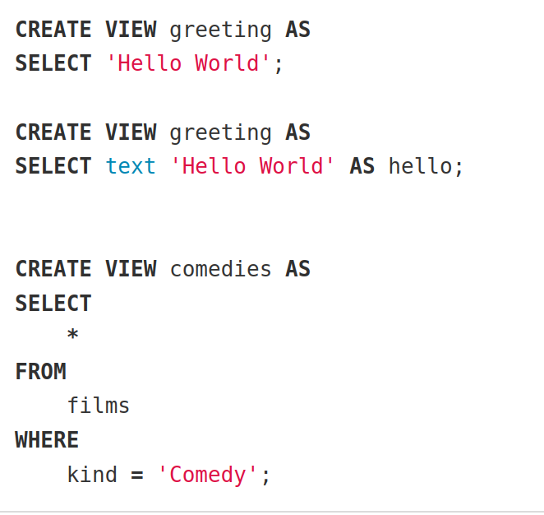
Creating a view
If you add columns to the table after creating the view, they will not be in the view.

Slide 16
TEMPORARY
The view is created as a temporary one. It is deleted at the end of the session.
CREATE TEMP VIEW greeting AS
SELECT 'Hello World';
RECURSIVE
The view is created as recursive. Equivalent forms:
CREATE RECURSIVE VIEW [ schema.
] view_name (column_names
) AS
SELECT ...;
CREATE VIEW [ schema.
] view_name AS
WITH RECURSIVE view_name (column_names) AS (SELECT ...)
SELECT column_names
FROM view_name;

Slide 17
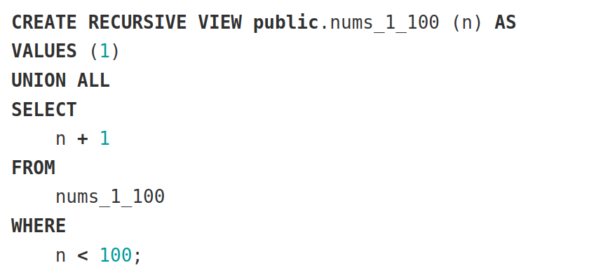
Recursive representation - example

Slide 18
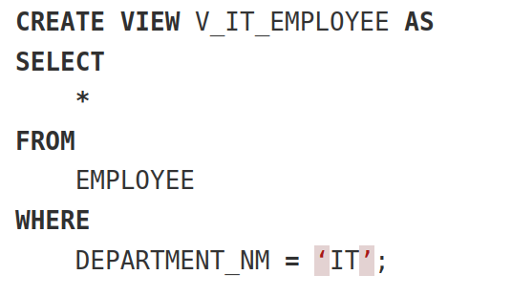
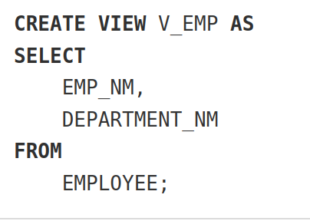
Types of views
horizontal — data restricted by rows:
vertical — data restricted by columns:

Slide 19
Updatable views
A view is called updatable if the UPDATE and DELETE operations are applied to it to change the data in the tables on which this view is built.
Requirements:
Exactly 1 source in the FROM clause, which is a table or an updatable view
The request must not contain WITH, DISTINCT, GROUP BY, HAVING, LIMIT or OFFSET
The request must not contain UNION, INTERSECT, or EXCEPT operators the select-list of the request must not contain aggregate, window, or functions that return sets.
WITH [ CASCADED | LOCAL ] CHECK
OPTION

Slide 20
Sets the behavior of updatable views: checks that do not allow writing data that is invisible through the view
LOCAL – checks are performed only on the view itself
CASCADED – checks are performed on the view itself, on the source, and so on along the chain of requests
Updated views – Example 1:
CREATE VIEW universal_comedies AS
SELECT
*
FROM
comedies
WHERE
classification = 'U'
WITH LOCAL CHECK OPTION;
An attempt to insert or edit a row with classification <> 'U' will result in an error.
But at the same time, inserting or editing a row with kind <> 'Comedy' will be successful.

Slide 21
Updated views – Example 2:
CREATE VIEW universal_comedies AS
SELECT
*
FROM
comedies
WHERE
classification = 'U'
WITH CASCADED CHECK OPTION;
An attempt to insert or edit a row with classification <> 'U' or kind <> 'Comedy' will result in an error.
Columns in the updated view can be either updatable or non-updatable.

Slide 22
Updatable views – Example 3:
CREATE VIEW comedies AS
SELECT
f.*,
country_code_to_name(f.country_code) AS country,
(SELECT avg(r.rating) FROM user_ratings r WHERE r.film_id = f.id) AS avg_rating
FROM
films f
WHERE
f.kind = 'Comedy';
All columns of the films table are updatable. The columns country and avg_rating are read only. If the view cannot be made updatable, but there is a need for it, use the INSTEAD OF trigger. This is a function that will handle data modification operations – we'll look at it later.

Slide 23
Note
Active use of views is a key aspect of good SQL database design. Views allow you to hide the internal structure of your tables, which may change as the application develops, behind reliable interfaces.
Views can be used almost anywhere that regular tables can be used. And quite often views are created on the basis of other views.

Slide 24
Practice
Assignment on database queries:
Value Generation Task:
1. Write a query to get the sum of numbers from 1 to 100.
2. Write a query to get the sum of an arithmetic progression with a step of 5, starting from 3 and ending at 48.
3. Write a query to get the sum of a geometric progression with a multiplier of 3 and the first element of 1, containing 10 elements, using the limit.

Slide 25
Practice
create table public.department (dep_id, par_dep_id, dep_name) as
select 1, NULL, 'Банк' union
select 2, 1, 'Управление анализа кредитных рисков' union
select 3, 2, 'Отдел риск-менеджмента малого и среднего бизнеса' union
select 4, 2, 'Отдел риск-менеджмента розничного бизнеса' union
select 5, 1, 'Департамент ИТ' union
select 6, 5, 'Управление хранилищ данных и отчетности' union
select 7, 6, 'Отдел очистки и контроля качества данных' union
select 8, 7, 'Группа администрирования хранилищ данных' union
select 9, 7, 'Группа контроля качества данных' union
select 10, 5, 'Отдел отчетности и витрин данных' union
select 11, 5, 'Отдел трансформации и загрузки данных' union
select 12, 11, 'Группа системного анализа' union
select 13, 11, 'Группа разработки';
Hierarchy Construction Task:
Let's assume there is a table containing the hierarchy of departments of a bank.
For each dep_id output a row in format «Группа, Отдел, Управление, ...» to which it relates;
Display dep_id of 5-th level structural divisions (i.e., «Группа системного анализа, Отдел трансформации и загрузки данных, Управление хранилищ данных и отчетности, Департамент ИТ, Банк»)

